Slide 1
HIMALAYAN MUSK DEER
BY- OISHIKA SANTRA

Slide 2
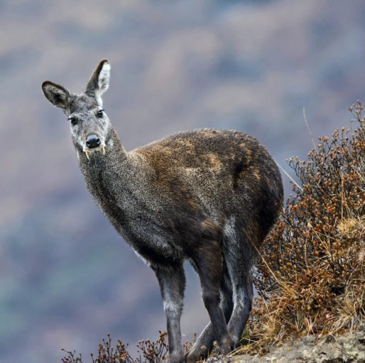
SCIENTIFIC NAME & COMMON NAME
The white-bellied musk deer or Himalayan musk deer is a musk deer species occurring in the Himalayas of Nepal, Bhutan, India, Pakistan and China. Its’ scientific name is Moschus leucogaster. It’s commonly known as “Kasturi mriga” in Nepali and “Lah” in Tibetan language.

Slide 3
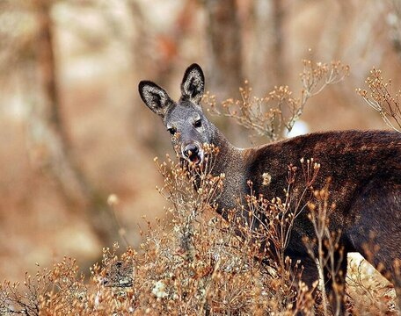
SYSTEMATIC POSITION
Kingdom: Animalia
Phylum: Chordata
Class: Mammalia
Order: Artiodactyla
Family: Moschidae
Genus: Moschus
Species: leucogaster

Slide 4
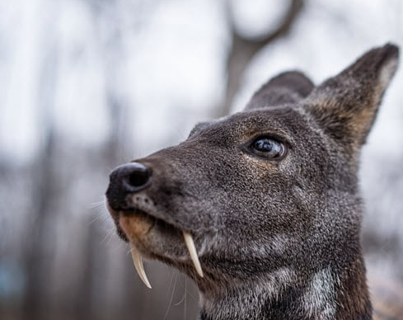
GENERAL BEHAVIOUR
During the day, white-bellied musk deer hide in dense cover and are shy and secretive. At night, they emerge to feed in more open habitats, They are sedentary occupying a small home range of up to 22 hectares. Males are fiercely territorial, only allowing females to enter their range. Territories are marked by carefully placed defecation sites and strong-smelling secretions, which are placed onto the surrounding plants. Males fight each other over females during the mating season and use their long canines to fight and defend their territories. The females hide from all the commotion. For the males to attract the females and bring them out from hiding, they use their strong smelling musk. Himalayan musk deer can live for up to 10 to 14 years.

Slide 5
BREEDING & FEEDING
They are dioecious and seasonal breeders. During the mating season, male Himalayan musk deer become anxious, competitive, and eat little. The females demonstrate exhaustion and attempt to stay in hiding. The male's musk sac is key in attracting females during the mating season; the sac emanates a strong smell meant to lure the females from hiding.
Himalayan musk deer mate between November and January. The gestation period is 185 to 195 days. One to two young are typically born between May and June and nurse from their mother for about 2 months. During this time, the young remain in hiding, independent of their mothers except when feeding.
Himalayan musk deer are herbivores and feed on what is seasonally available. Accordingly, they eat grasses, forbs, mosses, lichen, twigs, shoots, and plant leaves. They are ruminants, so they can quickly leave feeding grounds if threatened and further digest their food later when safe from harm. Occasionally, Himalayan musk deer travel great distances at night to forage for food. They may travel 3 to 7 km per night, but they always return to their usual territories by daybreak.
Primary Diet: herbivore
Plant Foods: leaves wood, bark, or stems bryophytes lichens
Other Food: Fungus

Slide 6
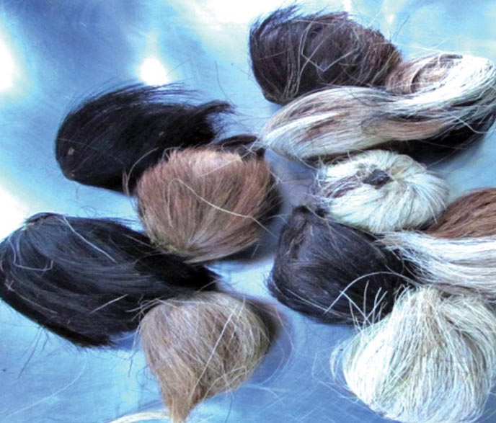
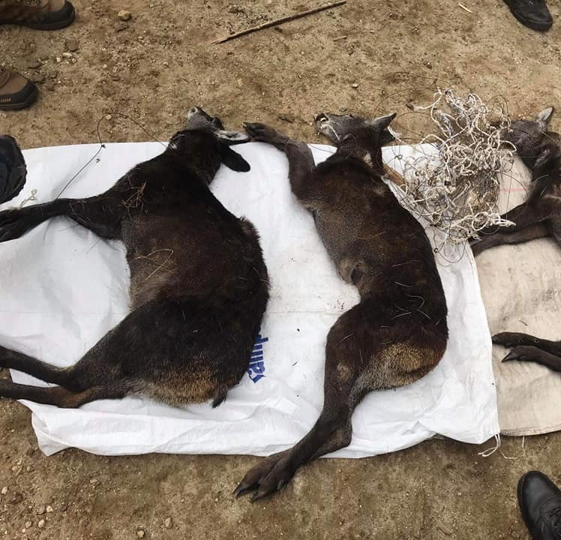
Current Status
Musk Deer’s survival is threatened most seriously by poaching.
Beside hunting for meat which is considered as a delicacy locally, hunting of Musk Deer is primarily due to the commercial demand of musk which is used in manufacture of perfume, medicine and cosmetics.
Red list Category and criteria: Endangered
Musk pod
Musk Deer killed by poachers

Slide 7
THANK YOU

